Slide 1
RNN(Recurrent Neural Network)

Slide 2

Why we need it? Limitations of CNN(Convolutional Neural Network)
In CNN Input and output size is fixed we can’t input image of varying dimensions to the network.
CNN does not have long term dependencies on the data so it can not memorize previous inputs.

Slide 3
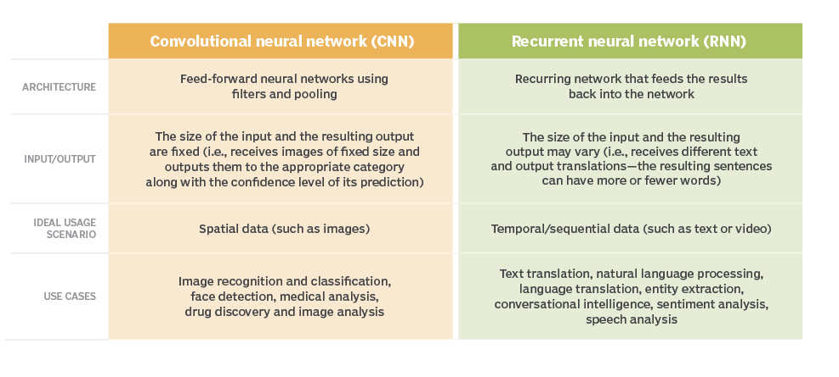
Difference between CNN and RNN

Slide 4
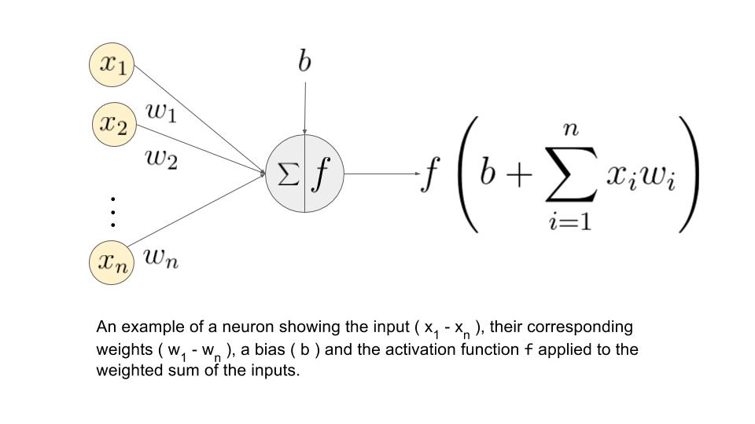
Mathematics behind of neural Network

Slide 5
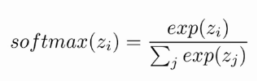
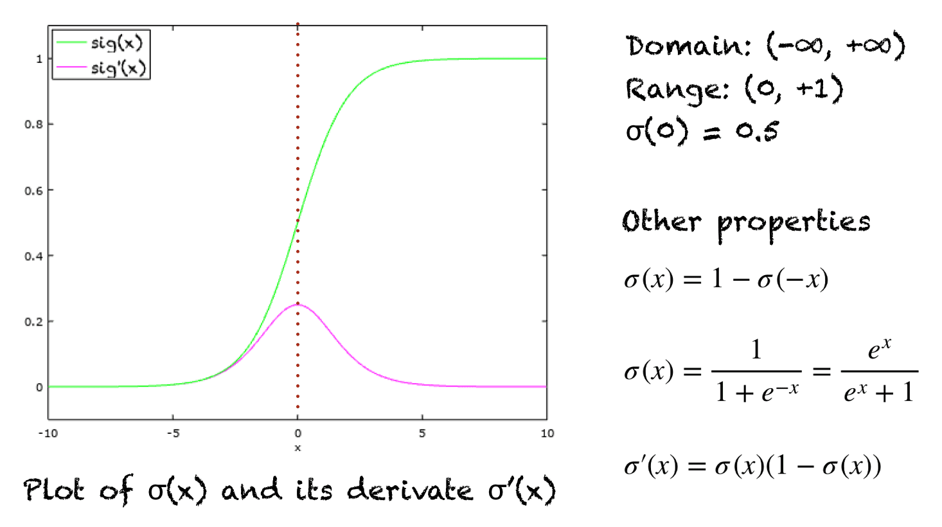
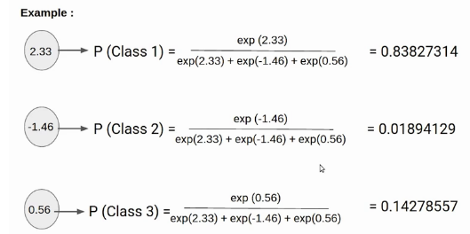
Activation Functions
Sigmoid activation function
Softmax activation function

Slide 6
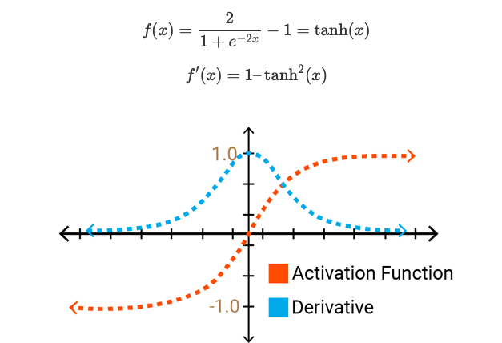
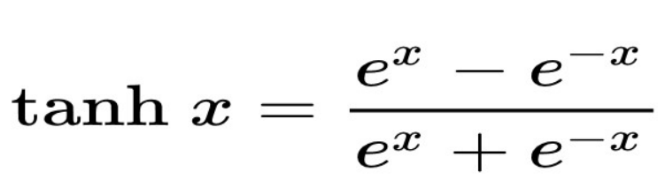
Hyperbolic Tanh activation function

Slide 7
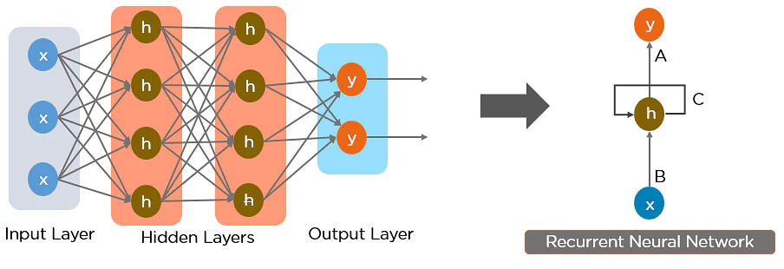
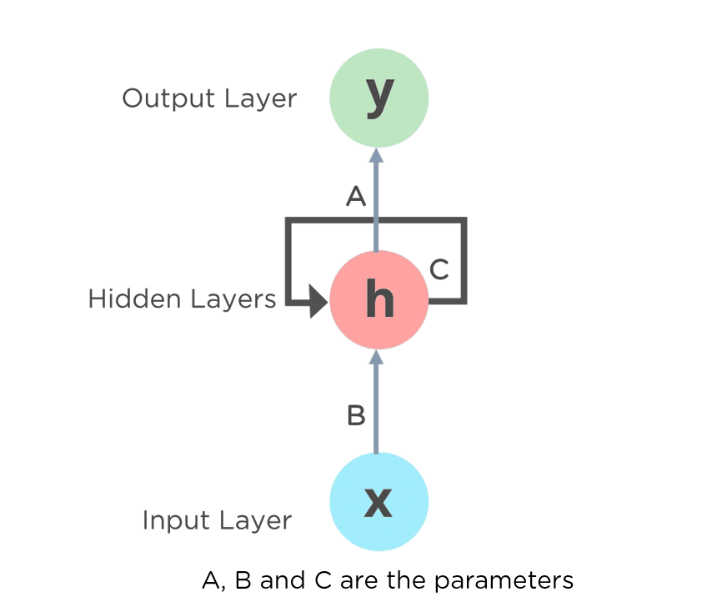
RNN
RNN works on the principle of saving the output of a hidden layer and feeding this back to the hidden layer.

Slide 8

Working of RNN

Slide 9
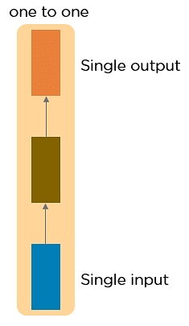
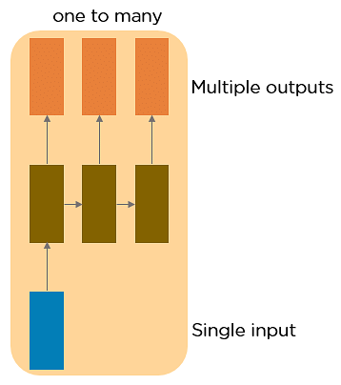
Types of RNN
One to One
One to Many
Input: Singer image
Output: A man playing
guitar
Input: Dog vs Cat
Output: 1 or 0

Slide 10
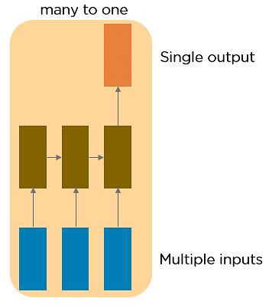
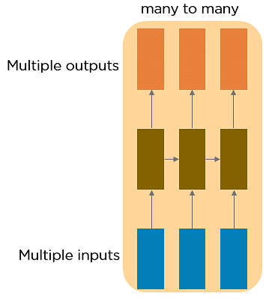
Types of RNN
Many to One
Many to Many
Sentiment Analysis
I/p: food was amazing
O/p: Positive (1)
Language translation
I/p: French language
O/p: English language

Slide 11
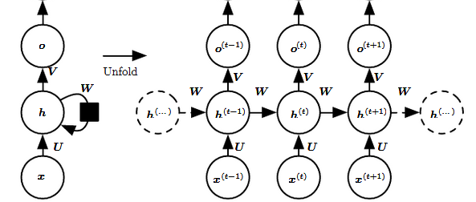
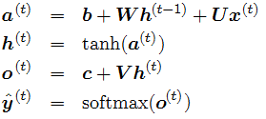
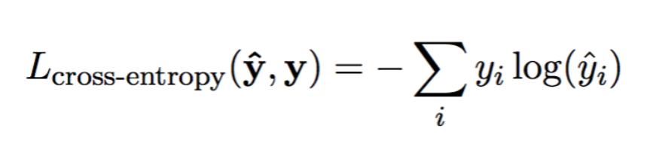
Forward computation equation of RNN

Slide 12
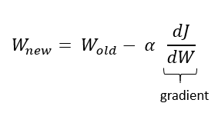
Limitations of RNN
Vanishing gradient problem
Exploding gradient problem
It occurs when the derivative or slope will get smaller and smaller as we go backward with every layer during backpropagation. problem occurs with the sigmoid and tanh activation function because the derivatives of the sigmoid and tanh activation functions are between 0 to 0.25 and 0–1.
It occurs when the derivatives or slope will get larger and larger as we go backward with every layer during backpropagation. This situation is the exact opposite of the vanishing gradients.
This problem happens because of weights, not because of the activation function.

Slide 13
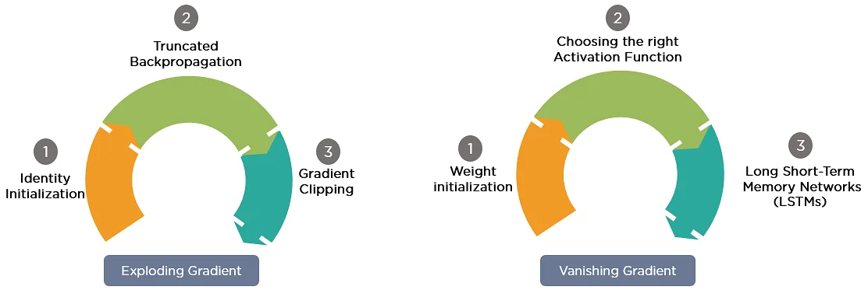
Gradient Problem Solutions

Slide 14
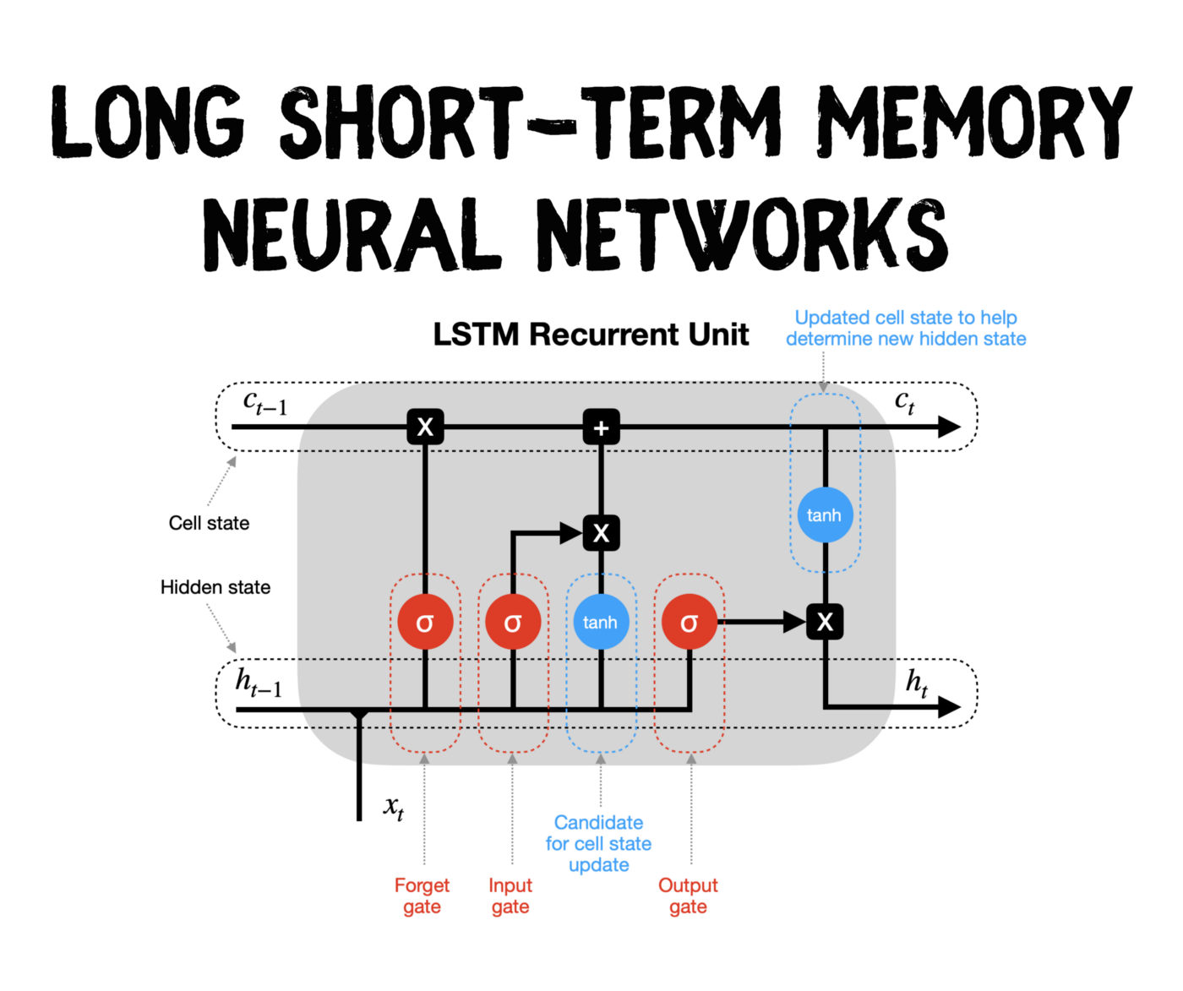
LSTM(Long short-term memory)
LSTMs are a special kind of RNN — capable of learning long-term dependencies by remembering information for long periods

Slide 15
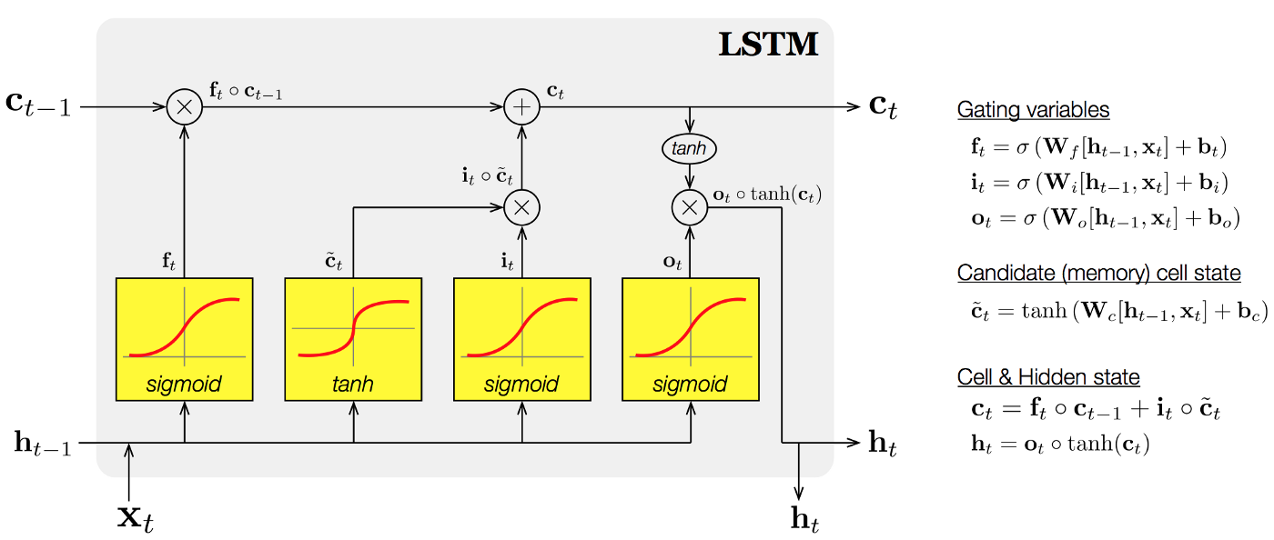

Slide 16
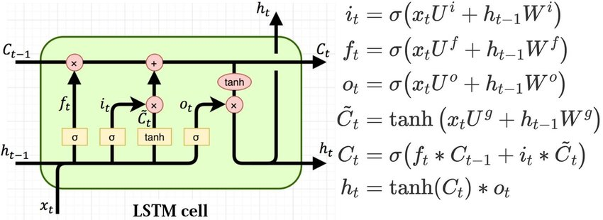
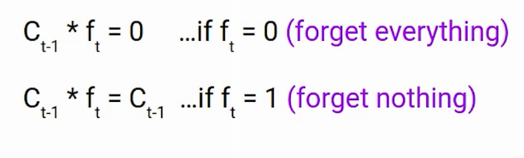

Slide 17
Thank You!

